Slide 1
Major Histocompatability Complex and immunity
Course outline
Discovery
Nomenclature
The function
Genes of MHC
Protein structure
Ag processing and presentation
MHC bind self peptides
Other Ags that activate T cells

Slide 2

Discovery
How the MHC got its name?
The term derives from research in transplantation that provide insight into the rules governing the acceptance or rejection of tissues (histocompatability).

Slide 3
Interaction with T cells
The function of MHC molecules are:
Ag presentation
to bind peptides that are produced when proteins are catabolized and to present these peptides to T cells

Slide 4
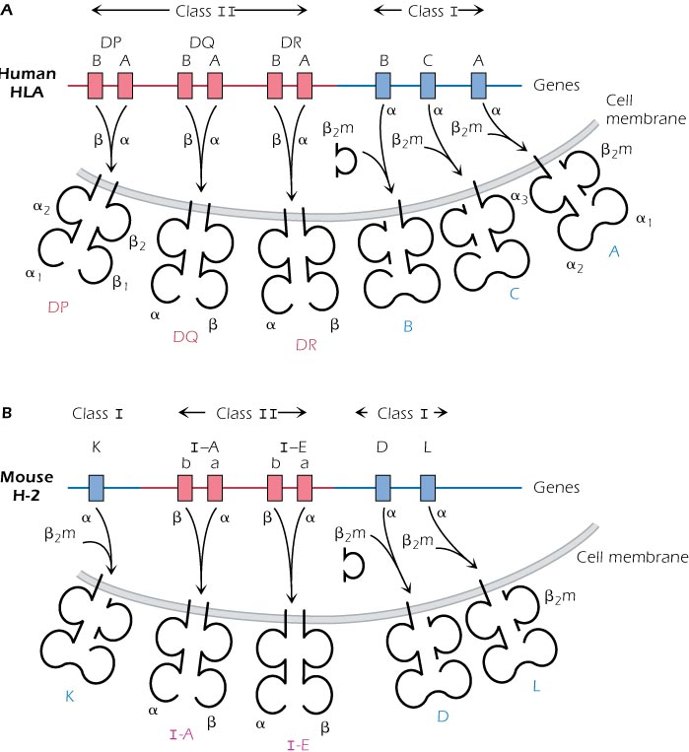

Slide 5
Genes of MHC
MHC genes are complex inherited as a unit. Includes two classes:
Class I region contains 3 independent genes.
the mouse MHC is called H-2: K, D, L
the human MHC is called HLA: A, B, Cw
Another gene does not belong to MHC but class I molecules are associated with it is called β2-microglobulin
Class II region contains 2 or 3 independent genes:
Murine H-2: I-A and I-E
Human HLA: DP, DQ, DR

Slide 6
Nomenclature
Originally, HLA molecules were characterized by serology using specific antibodies. So HLA-A2 differ from HLA-A25, HLA-DR14 from HLA-DR-16
According to PCR technology
HLA-DRB1*13 01: the letters to the left of the asterisk specify the HLA gene (DRB1) and the numbers to the right (4 or 6 or 8) define the particular allele
In mice, H-2 haplotype are given superscript letters e.g. H-2^{b,} in human, HLA are given numbers e.g. HLA-A4

Slide 7
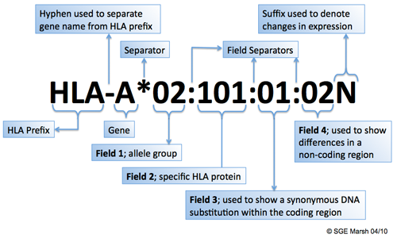

Slide 8
MHC gene characteristics
Polygenic:
MHC class I and II molecules are coded by multiple independent genes. In human, 3 indep. Genes A, B, C codes for class I molecules expressed at the cell surface .
Each cell has 2 sets of chromosomes (1 maternal and 1 paternal)
Also 3 different MHC class II molecules DP, DQ, DR
Polymorphism
multiple stable forms of each MHC genes exist in the population. MHC is the most highly polymorphic gene system in the population.
Hundreds of slightly different versions (alleles) of each of the MHC genes are identified.
The enormous diversity of MHC genes is the major barrier to successful transplantation of organs.
Although MHC molecules are diverse within the population, each cell in a particular person (liver, kidney…..) expresses the same set of HLA class I and II molecules.

Slide 9
Codominant expression
every cell expresses MHC molecules transcribed from both the maternal and paternal chromosomes.
Thus, every nucleated cell of a particular person expresses up to 6 different HLA class I and 6 different HLA class II molecules.
Some individuals expresses fewer than 6 because they are homozygous for a particular allele
Coordinate regulation
All class I and II molecules are expressed at the same time on a single cell
Class I and II are regulated separately: class I can be expressed in the absence of class II molecules

Slide 10
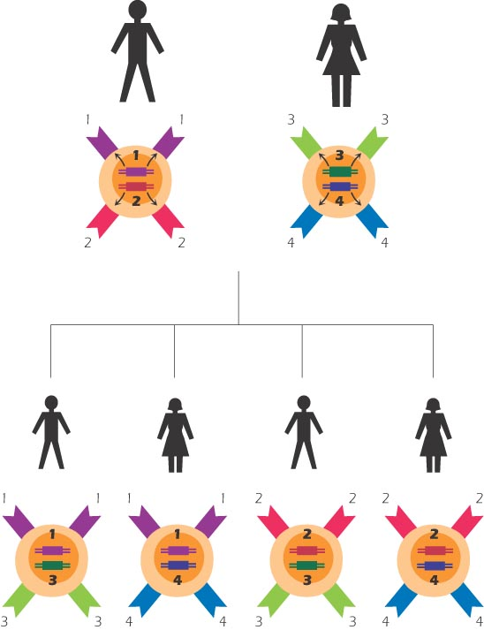
Inheritance:
-A haplotype (the set of HLA class I and II genes
expressed on an individual chromosome) is
passed on to offspring as a unit
-Each parent expresses one haplotype
different from each child and each child
one haplotype different from each parent.
-Every child in the family expresses a different
set of HLA haplotype (1 in 4 chance that 2
siblings will have identical haplotype)
-The Likelihood of 2 individuals in the
general population who are matched at
all HLA alleles is extremely small

Slide 11
Because HLA genes are located at adjacent loci on the particular region of a chromosome and presumed to exhibit epistasis with each other or with other genes, a sizable fraction of alleles are in linkage disequilibrium
The loci encoding the major histocompatibility class II cell surface antigens DR, DQ, and DP exhibit a remarkable degree of allelic polymorphism. Strong linkage disequilibrium is also found between these loci in the human population.
Alleles are in linkage disequilibrium when they do not occur randomly with respect to each other.
LD: Alleles in near physical vicinity are not inherited independently but as blocks (haplotypes).

Slide 12
Other genes within HLA
In the class I region:
HLA-E, HLA-F, and HLA-G
Function: unknown but HLA-G expressed by placental trophoblast cells prevent the rejection of the fetus by the maternal host.
class II region includes:
HLA-DM involved in peptide exchange in the MHC class II pathway for Ag presentation, TAP-1 and 2 involved in the MHC class I Ag presentation pathway

Slide 13
At the protein level
Structure of MHC class I molecules
A transmembrane glycoprotein expressed in noncovalent association with a small invariant (identical) polypeptide called β2- microglobulin.
Consists of α heavy chain that Comprises 3 extracelluar Ig-like domains α1, α2 and α3.
β2- microglobulin has a structure homologous to a single Ig domain. The α1 is paired with α2 and α3 with β2- microglobulin.
Has a peptide-binding groove that resemble a basket with an irregular floor (β-pleated sheet) surrounded by walls (α-helices). The groove holds 8-9 a.a. long

Slide 14
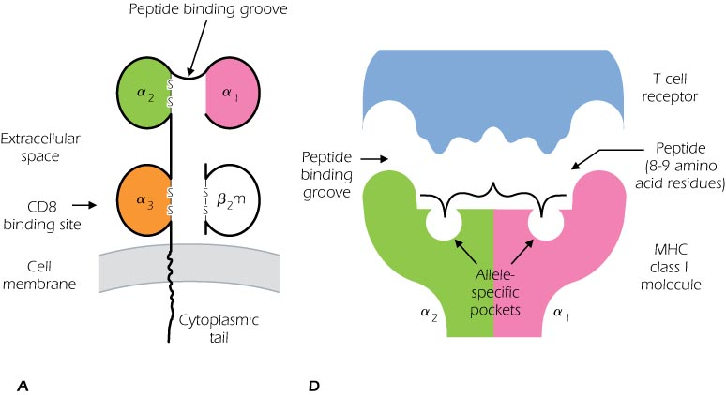

Slide 15
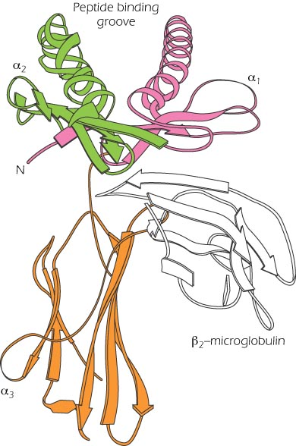

Slide 16
An individual MHC molecule can be divided into a polymorphic or variable region and a nonpolymorphic region that is similar in all MHC class I molecules.
Presence: found on all nucleated cells of an individual and are identical
CD8 binds to the nonpolymorphic region of all MHC class I molecules , specifically in the α3 domain
Binding of an MHC class I molecule to a peptide is selective:
One MHC molecule will bind with high affinity to only certain peptides.
A single MHC molecule can bind to a variety of peptides but binds preferentially to peptides with certain motifs(closely related a.a. at certain positions.

Slide 17
Structure of MHC class II molecules
A transmembrane glycoprotein comprising 2 chains α and β. Like class I molecules.
Every MHC molecule is expressed at the cell surface with 4 domains. The α1 is paired with β1 and α2 is paired with β2.
Like class I molecules: class II molecule contains a peptide-binding groove at the top of the molecule.
In contrast to the 8-9 a.a peptide that bind class I, the MHC molecule binds peptides between 12-17 a.a
Like MHC class I molecules, MHC class II molecules are composed of polymorphic and nonpolymorphic regions . CD4 T cells binds to the nonpolymorphic region of all MHC class II molecules, specifically in the β2 domain.
Presence: on some immunological cells including APCs, thymic epithelial cells, Mac in the mice, activated T cells in human

Slide 18
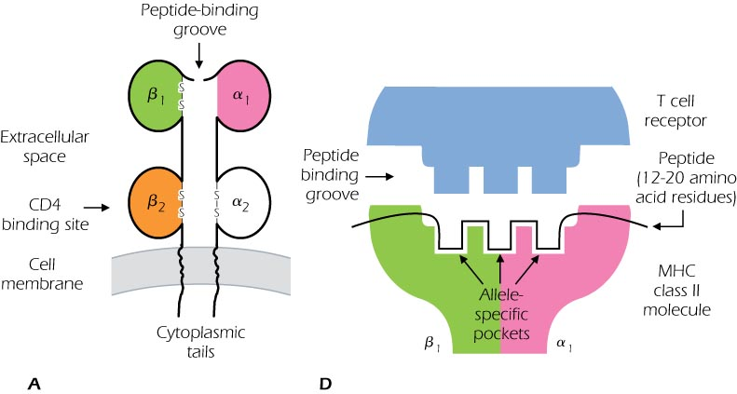

Slide 19
Ag Processing and presentation
Exogenous Ags:
are Ags that come from outside a host cell and are taken inside by endocytosis or phagocytosis.
Ags derived from bac, viruses or vaccines that do not injure the host.
Ag presenting cells (APC): dendritic cells, mac, and B cells take up exogenous Ags
Ag presentation
1. Endocytosis: the protein is internalized in an intracellular vesicle that are highly acidic (pH4). These contains proteases as cathepsins that cut proteins into peptides to yield several peptides

Slide 20
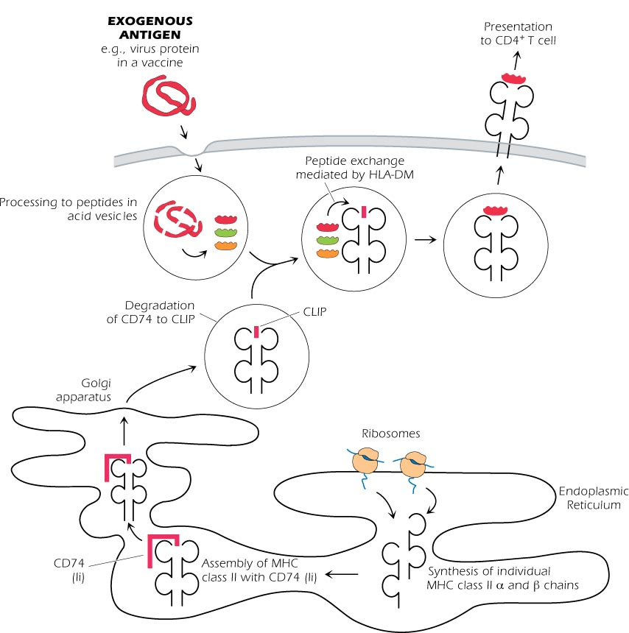

Slide 21
2. The MHC class II are synthesized on ribosomes and are assembled in the ER with an invariant chain (Ii).
a. Ii binds the groove of MHC preventing the binding of other peptides.
b. Ii act also as a chaperone for the newly synthesized MHC. This allows MHC to leave the ER and enters the Golgi.
3. In Golgi, removal of Ii occurs in stages. Ii is partially degraded leaving a fragment known as Class II-associated Invariant polypeptide (CLIP)

Slide 22
4. The MHC-CLIP leaves Golgi and enters acid vesicles (endosomes or lysosomes).
A molecule HLA-DM catalyze peptide exchange between the MHC-CLIP and peptides derived from exogenous Ags to form MHC-peptides.
5. This complex moves to the cell surface to present the peptide.
Although catabolism of a protein yields several peptides, not all the peptides bind to MHC because binding is selective. Unbound Peptides to MHC, do not trigger CD4+ T cell response.
Every person will make a T cell response, because of selectivity, individuals who express different MHC molecules respond to different parts of the same protein

Slide 23
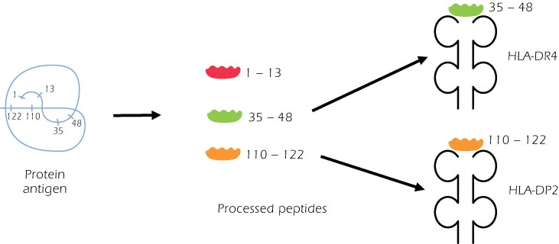

Slide 24
Endogenous Ags
These Ags are synthesized inside a cell and are derived from pathogens that have infected the host cell.
Processing occurs in the cytoplasm via a giant E known as the Proteasome that cleaves proteins into peptides about 15 a.a. in length.
Some peptides are destroyed but some are transported into ER by a peptide transporter(a product of 2 genes TAP-1 and TAP-2)

Slide 25
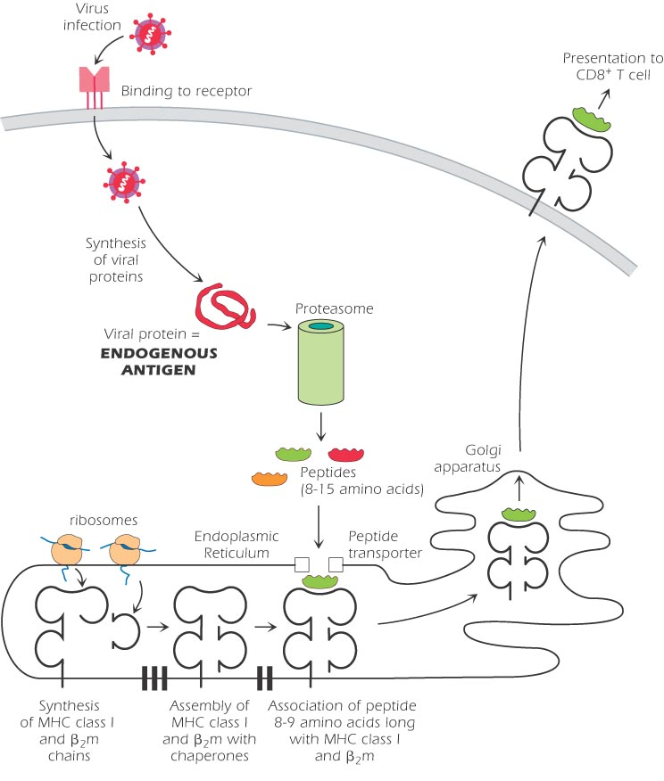

Slide 26
3. MHC class I and β2-microglobulin are synthesized separately and associate in the ER.
The chaperon (tapasin) direct the transport of the complex to Golgi. MHC class 1 molecules preferentially bind peptides 8-9 a.a in length.
4. The MHC class I-peptide complex is presented on the surface to CD8+ T cell

Slide 27
Because MHC class I molecules are expressed on all nucleated cells, the presentation of Ags occur in every cell in the body.
Some viruses inhibit the synthesis of MHC class I molecules or interrupt the transport of peptide-MHC complexes to the cell surface.
Thus, the virus decreases expression of MHC molecules and so decrease the CD8 T cell response to the virus. Tumor cells show decreased expression of MHC class I compared to normal cells
Although the decrease in MHC class I decrease the T cell response, it may trigger the NK cell responses to the viral-infected cell or tumor cell.

Slide 28
Cross-presentation
Exogenous Ags are presented in the MHC class I pathway.
Proteins from bac, most viruses, allergens and harmless Ags all trigger CD4+ T cell. Infectious pathogens activate class I associate with MHC molecules pathway
The processing pathway rather than inherent properties of the Ag, determine whether a protein is presented to CD4 or CD8 T cells.
Self proteins bind MHC class I and class II molecules but do not normally activate T cells.

Slide 29
Other Ags that activate T cell response
1. Lipids and Glycolipds
Some T cells recognize lipids and glycolipids found in the cell wall of pathogens such as M. tuberculosis that live inside Mac.
The lipids are presented by a family of molecules known as CD1 expressed by APC.
CD1 are surface glucoprotein coded for outside the MHC region. Like MHC class I molecules, they are expressed on the surface of APC in association with β2-m.
The structure also similar to MHC class I with a larger groove. The deep groove binds the hydrophobic part of the lipid Ag, and the polar region binds The TCR.
HSV 1 downregulates expression of CD1 and thus inhibit Ag presentation
CD1a,b,c present lipids to T cells with TCR, but CD1d present lipids to NKT cells.

Slide 30
SuperAg:
-Predominately bac exotoxins such as S enterotoxin.
-is not processed but the intact molecule binds to MHC class II molecules outside the groove.
SuperAgs activate up to 10% of total T cells. This massive activation release CK that is responsible for toxic shock

Slide 31
